Slide 1
Data warehousing
Relational databases KC4000

Slide 2
Aims
Recap the Relational Model
The discrepancy between how the RM manages data and the way some organisations require data to be used
Key differences between Relational Databases and Warehousing Databases
Example of a warehouse integration system.

Slide 3
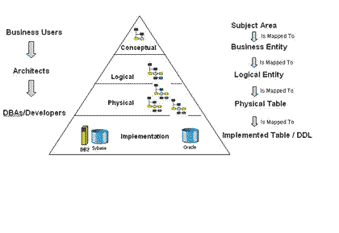
Relational Model
Devised by Codd/IBM
Standardised the approach to data management by focusing on the behaviour of the data and its usage
12 rules that are the backbone to the model
The standard for databases for the last 30 years

Slide 4
Discrepancies between Relational and business need
Relational databases most commonly used for OLTP (online transactional processing)
Data is normalised to ensure optimum performance for read/write transactions. Traditional business database are built to hold current transactions and gain efficient access to specific transactions for ongoing business processes.
Increasingly organisations require data from multiple sources within an organisation for reporting or analysis.
Traditional relational databases are not efficient for online analytical processing (OLAP). Organisations often need data that is optimised to reading and aggregating very large data sets for trend analysis etc. This is not efficient in a traditional database.
A data warehouse is a database system that is designed for large datasets analytics

Slide 5
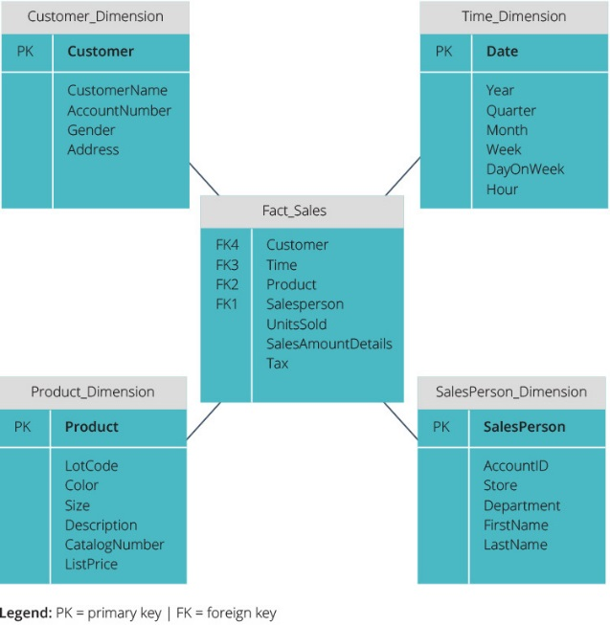
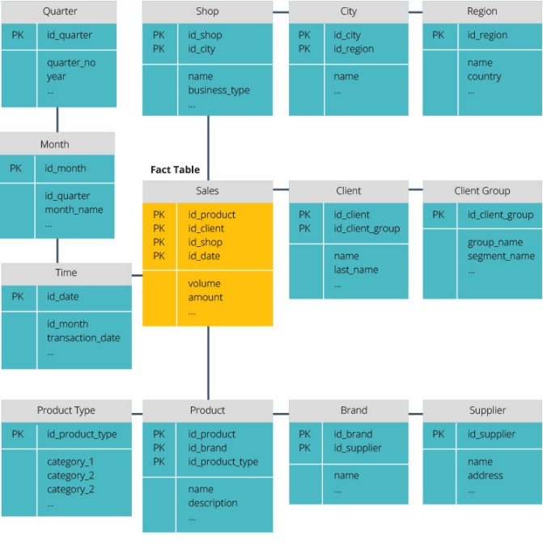
Data warehouses
Different approach to data
De-normalised data storage
2 approaches
Inmon methodology – warehouse is created, data is summarised and distributed from warehouse to dependant data marts
Kimball architecture – organisations create separate data marts based on departmental need and the warehouse is the combination of all these data marts
Star schema & Snowflake schemas rather than relational schema
Data should never be inputted it should always be derived or pulled from underlying systems
Splits fact table into series of normalised dimension tables, reduced data integrity issues but more complex querying
Emphasis is on query speed, only one join is needed to link fact tables to each dimension, easy querying

Slide 6
Industrial example
Global organisation with multiple subsidiary companies needs to have oversight of transactional data for analysis and reporting by a range of filters/groupings. It decided to create a warehouse which would feed a number of data marts that would be accessed by departments as deemed necessary.
Company had a range of systems running as each subsidiary had a different OS, DBMS, SAP/equiv system running and each subsidiary also retained different information.
Data was not held in a standard format across subsidiaries so data needed to be standardised before it could be consolidated
Customers in common but not by same identifier
E Phillips 26th August 1972
Customer 123
Emma J Phillips 26/8/72
E J Phillips 8/26/1972

Slide 7
Simplified solution
Extract data during batch run overnight
Pass data into a staging area
Run cleansing procedures
Consolidate data & migrate to ‘live’ area
Create data marts for subviews
Chromium
Europe
Latex
HO
What happens if the batch file doesn’t run?
Data for that company cannot be processed unless that data is extracted and cleansed as data is culminate
Have to check the file that is received and the file that is expected
How do you identify the expected file and validate the delivered file?
How do you cleanse the data?
Pay to standardize the data – index of customers in translation table within the staging area?
Change the business rule – not ideal and defeats the object
Flat file
Flat file
Flat file
Flat file
Staging Area
Clean data
LiveArea
DM
DM
DM

Slide 8
Seminar work
Looking at another industrial case to identify issues and ways that they could be overcome

